Slide 1

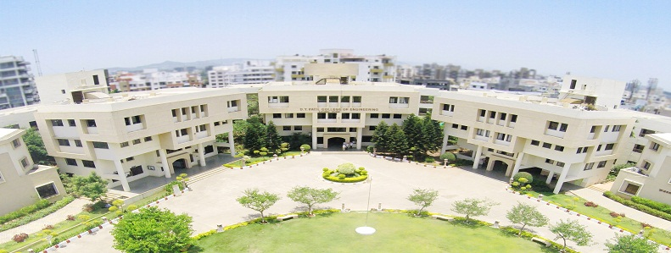
D. Y. Patil College of Engineering, Akurdi, Pune
Project Stage II
On
Water Quality Prediction Using Machine Learning
Presented By:
Mansi Adhav : BEITA07
Sonal Chidrawar : BEITA13
Dhairyashil Pawar : BEITA38
Hrutik Chaudhari : BEITA63
Guided by:
Mrs. Priyanka Gupta

Slide 2

Overview
Introduction
Literature Survey
Methodology
Software Tools / Technologies
Algorithms / Techniques Used
Data Analysis
UML Diagrams’
Field Work
Implementation Snapshots
Sample Result
Conclusion

Slide 3
Introduction
The water quality predictor project aims to leverage machine learning techniques to assess the potability of water based on various key parameters.
By analyzing a dataset containing information on features like pH, hardness, and chloramine, the project addresses the crucial need for ensuring access to safe drinking water.
Through the implementation of a Random Forest classifier and a user-friendly interface, users can input water quality metrics and receive predictions, contributing to the broader goal of safeguarding public health by identifying potable water sources.

Slide 4
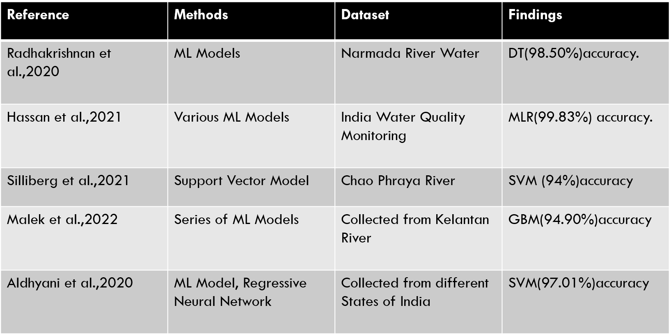
Literature Survey

Slide 5
Software Tools / Technologies
Software Requirements
Programming Language: Python.
Web Framework: Flask
Tools
Version Control : Git for version control to track changes and collaborate.
IDE : Visual Studio Code
Package Management
pip (Python Package Installer) for managing backend dependencies.
Machine Learning
Python libraries such as scikit-learn, numpy, pickle for implementing machine learning model.

Slide 6
METHODOLOGY
Data Collection: Gathered a dataset containing water quality parameters, including pH, hardness, and chloramine.
Exploratory Data Analysis (EDA): Conducted thorough exploration of data, examining distributions, correlations, and class imbalances.
Outlier Detection and Handling: Employed Tukey's method to identify and remove outliers in critical features, ensuring data robustness.
Data Preprocessing: Handled missing values through mean imputation for essential features like pH and sulfate.
Model Selection and Training: Chose a Random Forest classifier for its ensemble learning capabilities.
Feature Importance Analysis: Visualized and analyzed the importance of features to understand their contribution to predictions.
Graphical User Interface (GUI) Implementation: Developed a user-friendly UI using flask for easy interaction with the predictive model.

Slide 7
Algorithms / Techniques Used
DT : Decision Tree, A Tree-like Model For Decisions Based On Conditions.
Accuracy using DT : 57%
LR : Logistic Regression, A Statistical Method Used For Binary Classification.
Accuracy using LR : 62%
RF : Random Forest, An Ensemble Learning Method Using Multiple Decision Trees For Improved
Accuracy using RF : 68%
SVM : Support Vector Machine, A Machine Learning Algorithm For Classification And Regression Tasks. Accuracy Using SVM: 61%
Random Forest has achieved highest accuracy of : 66%

Slide 8
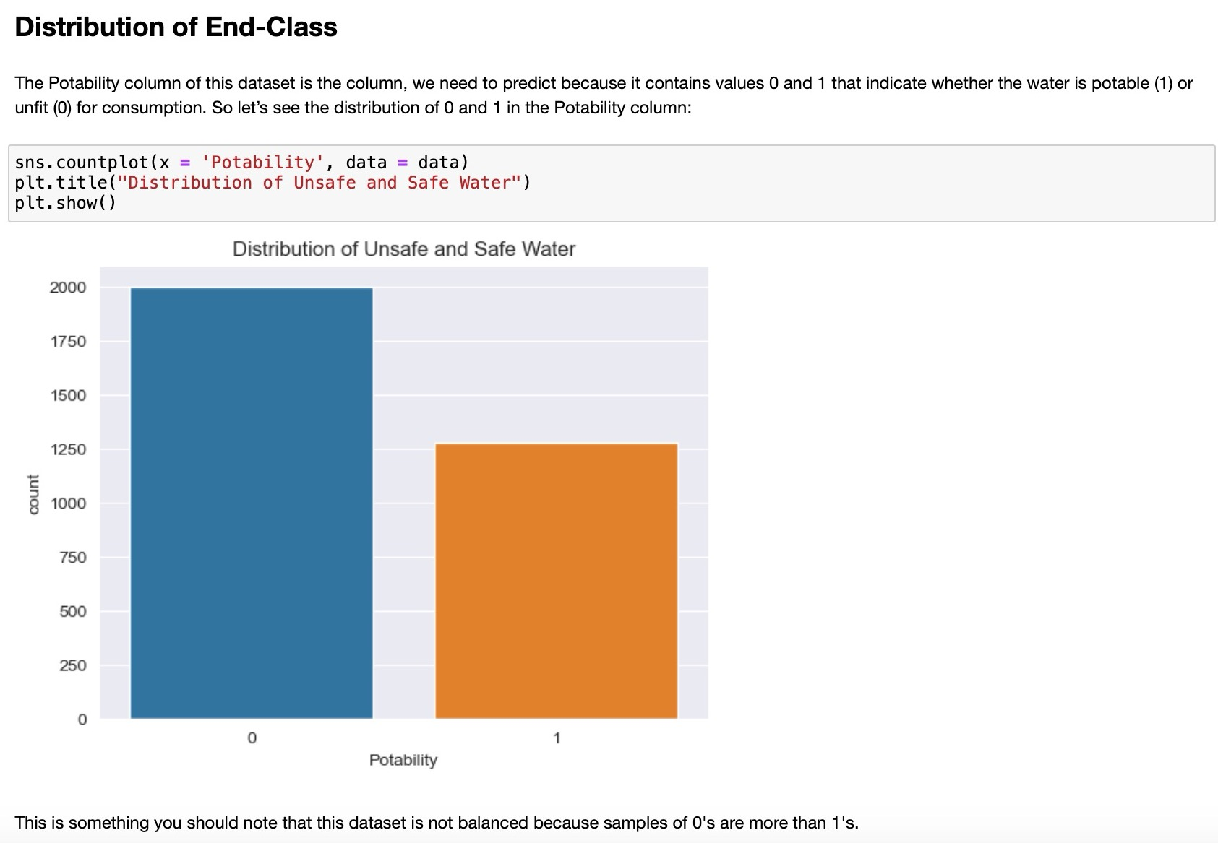
Data Analysis
Data analysis in machine learning involves the process of collecting, cleaning, and exploring data to prepare it for training model.
This includes tasks like selecting relevant features, handling missing values, and scaling data.
The goal is to understand patterns and relationships within the data, improving the performance of machine learning models during training and evaluation.

Slide 9
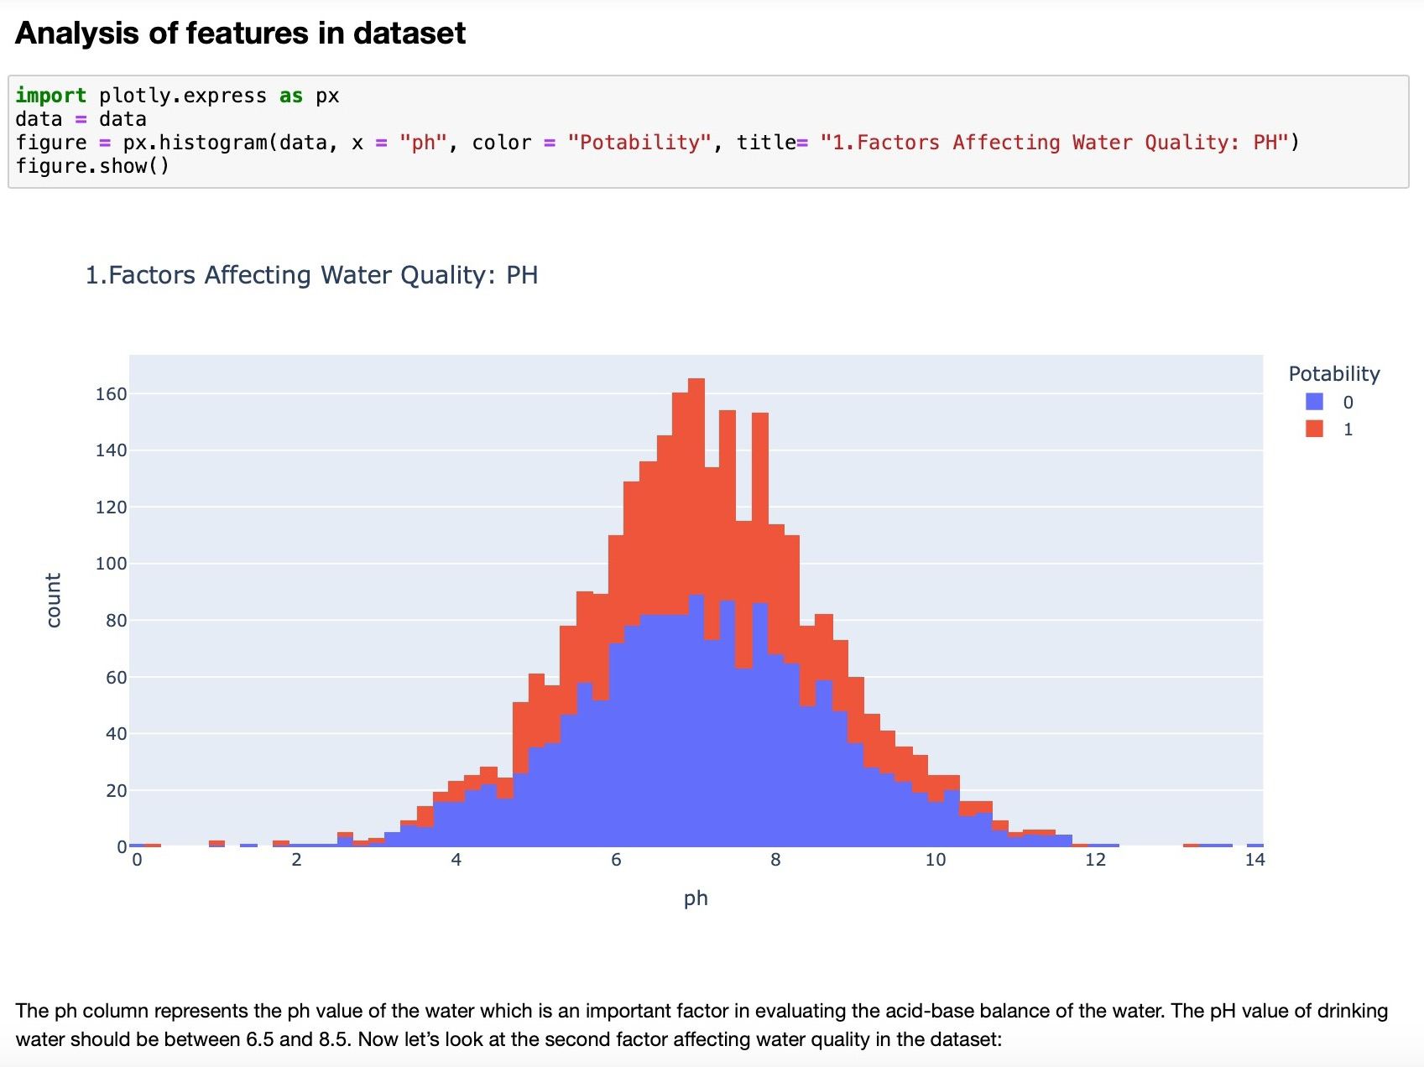
Data Analysis
Feature analysis in machine learning refers to the process of examining and understanding the input variables (features) used to train a model.
This involves assessing the relevance, importance, and relationships among different features to enhance the model's performance.

Slide 10
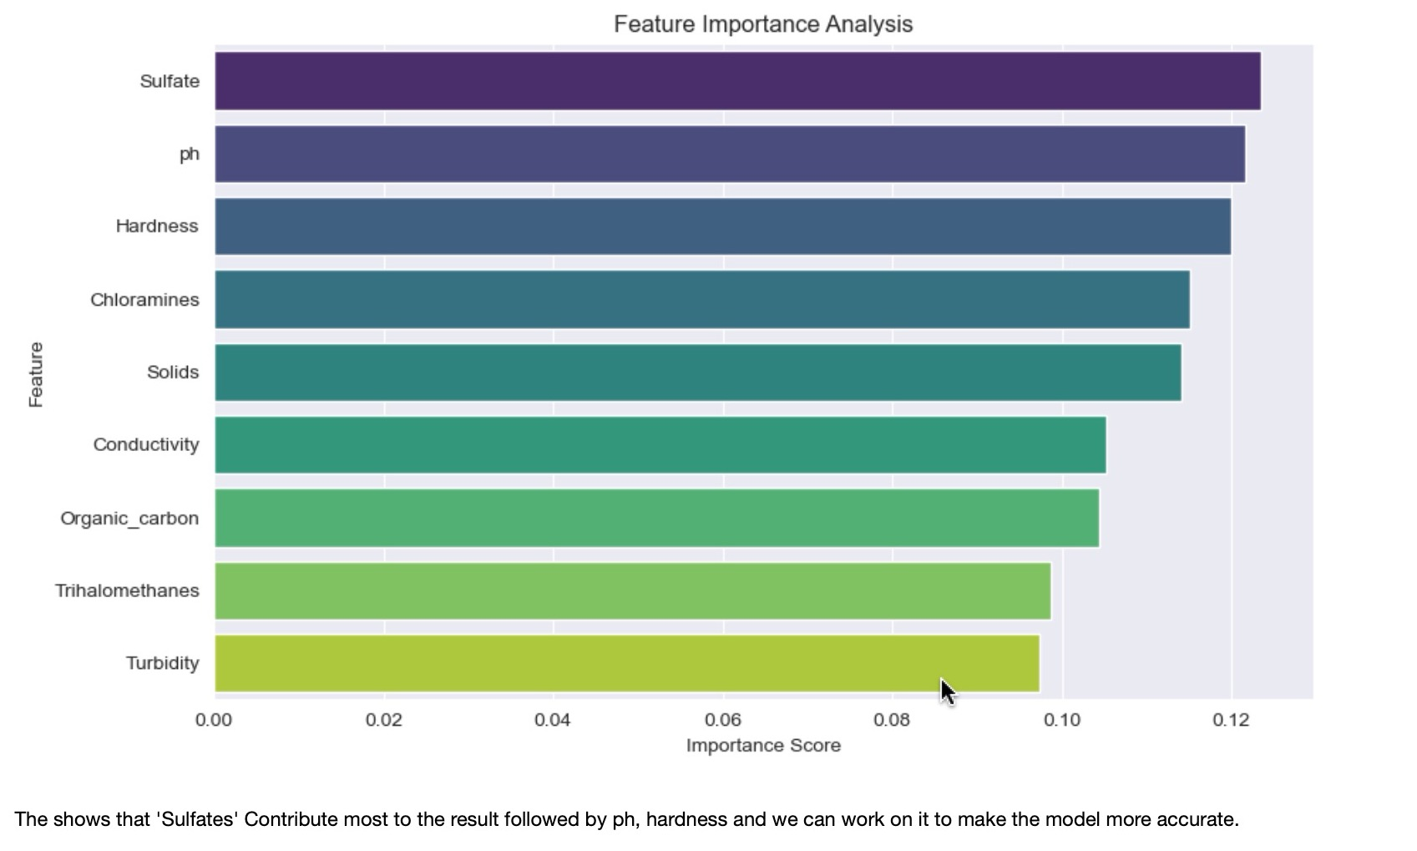
Data Analysis
Feature importance analysis helps in understanding the contribution of each feature in your Random Forest model's predictions.

Slide 11
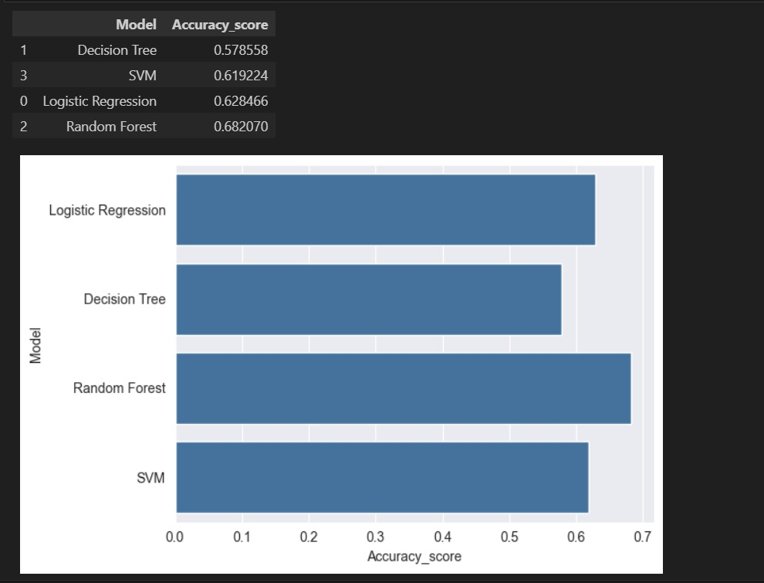
Selection Of Machine Learning Model

Slide 12
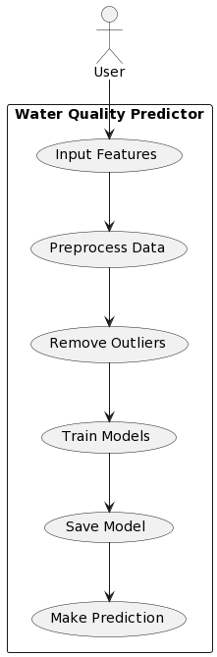
Use Case Diagram

Slide 13
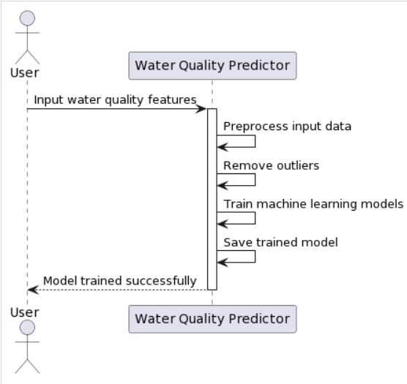
Sequential diagram

Slide 14
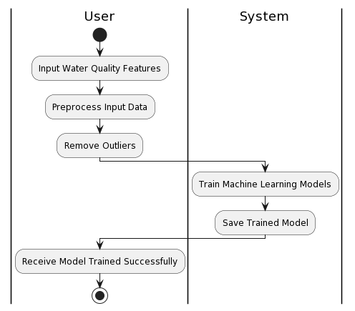
Activity Diagram

Slide 15
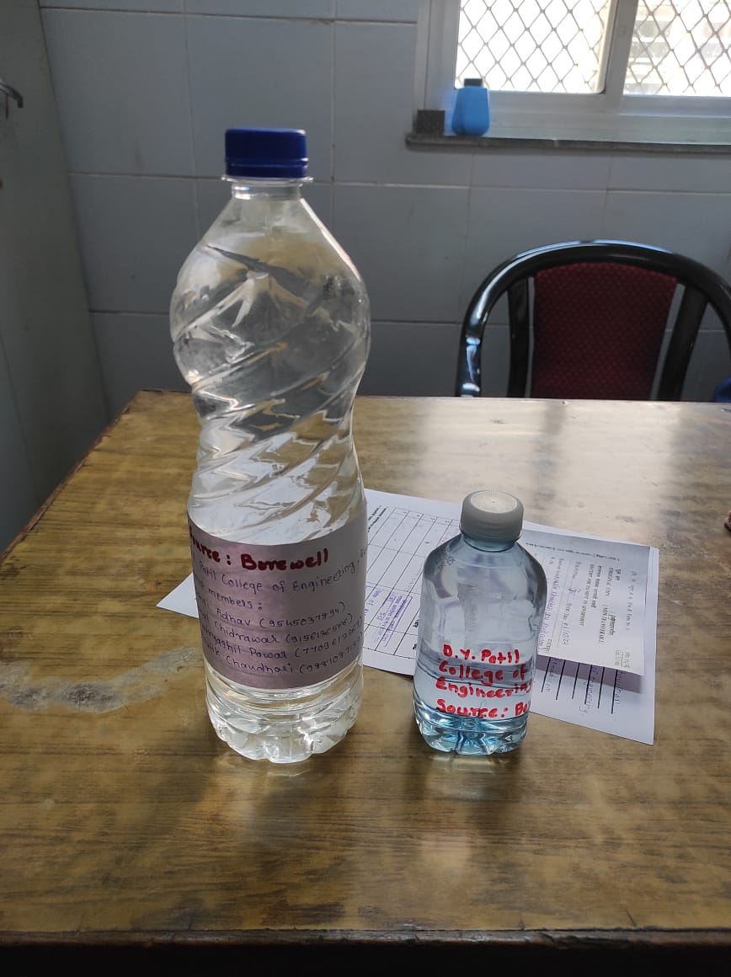
Field Work
Collected Water Sample:

Slide 16
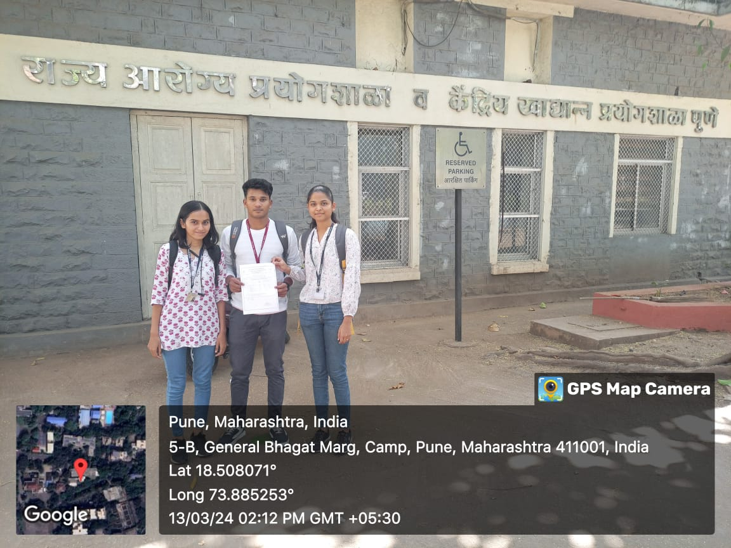
Field Visit

Slide 17
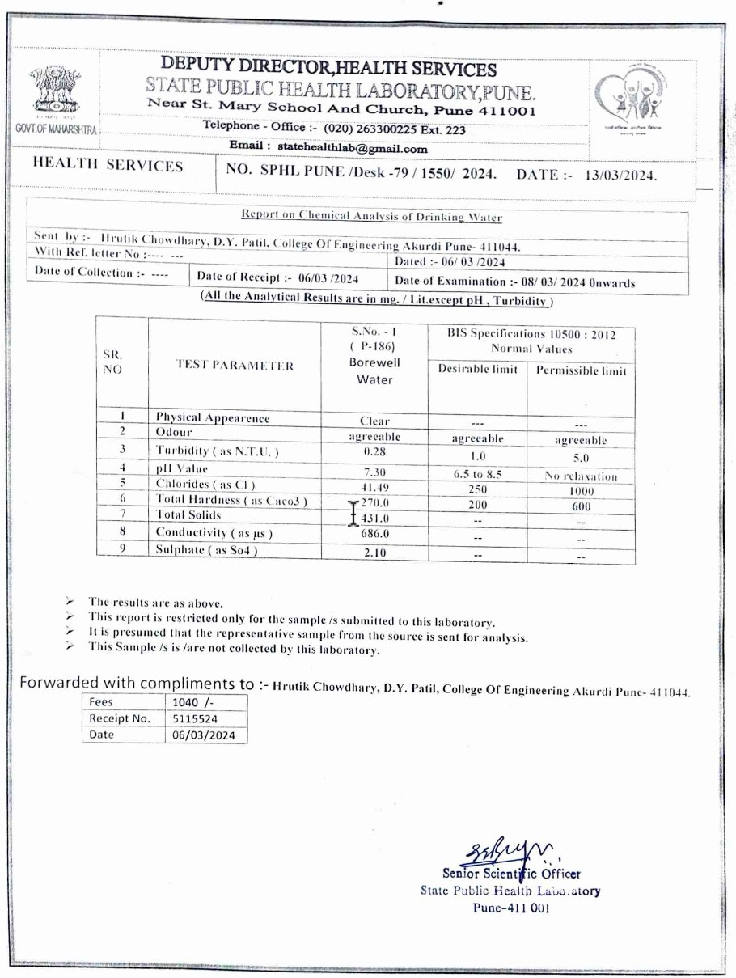
Water Sample Test Report

Slide 18
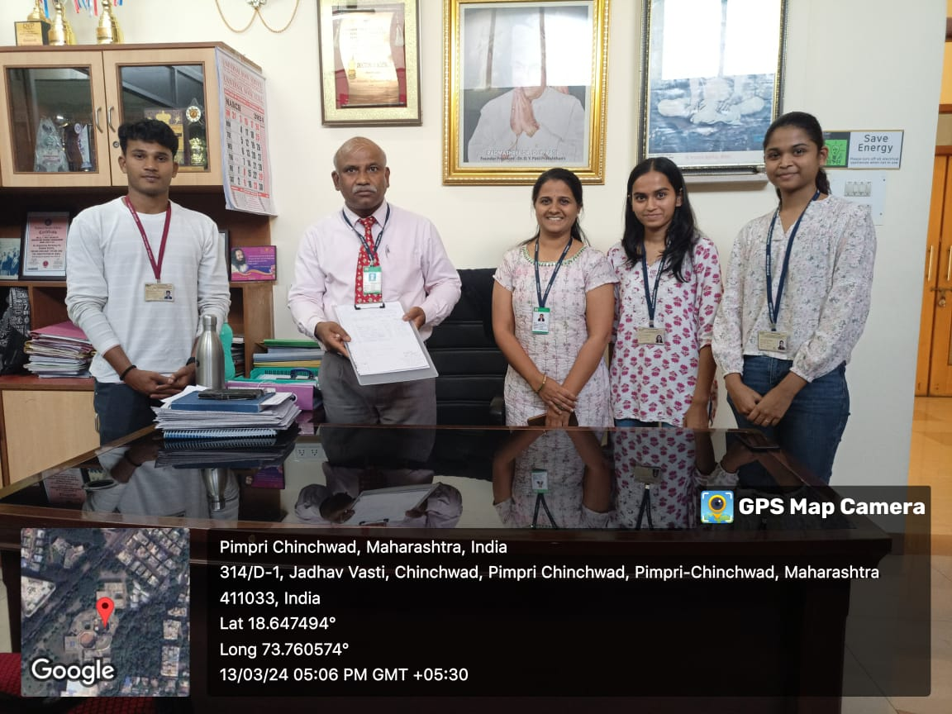
Consultation with Agricultural Professor

Slide 19
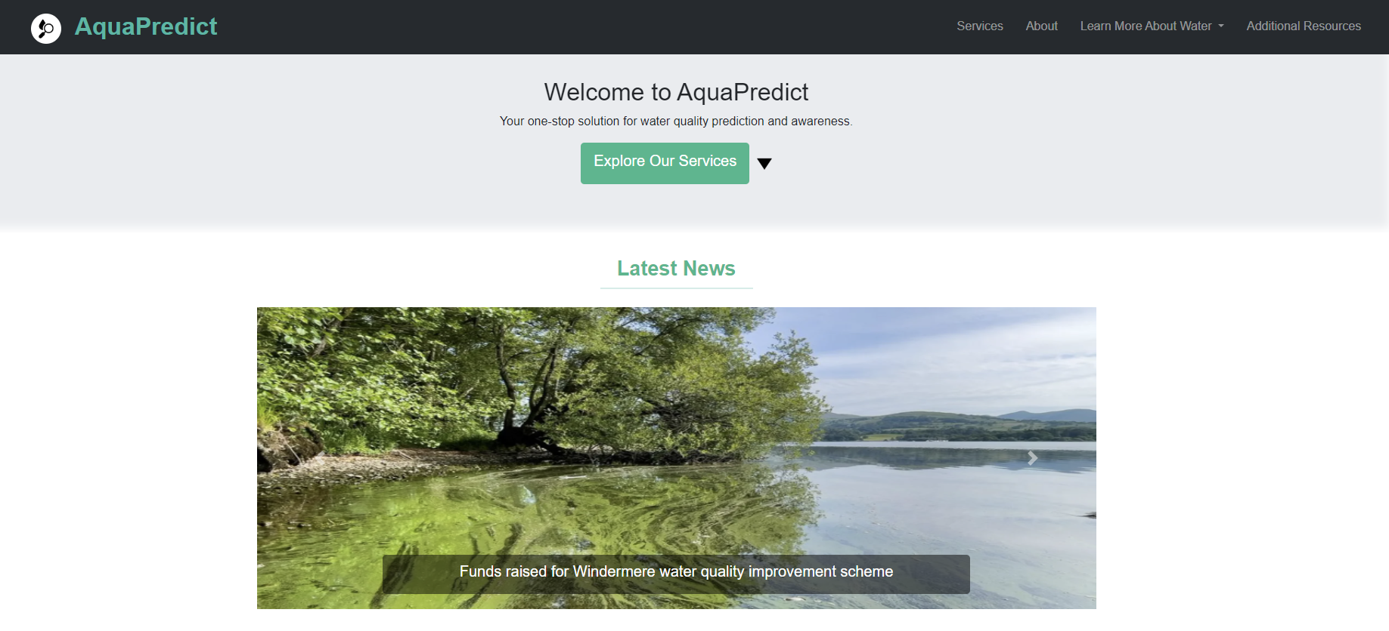
Implementation Snapshots
Auto-scrolling banner featuring global news on water management and pollution.

Slide 20
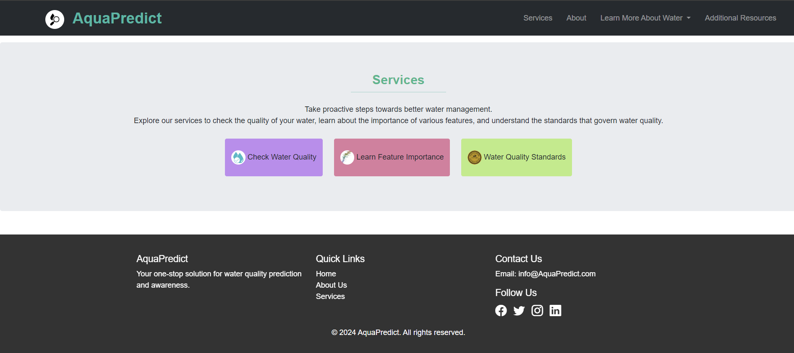
Services offered: Water quality checking, feature importance, and water quality standards

Slide 21
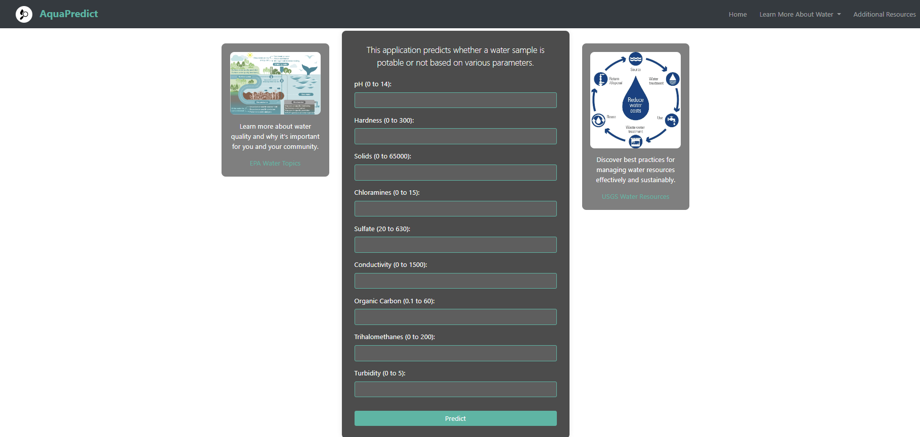
Data entry page for users to input water quality parameters for analysis

Slide 22
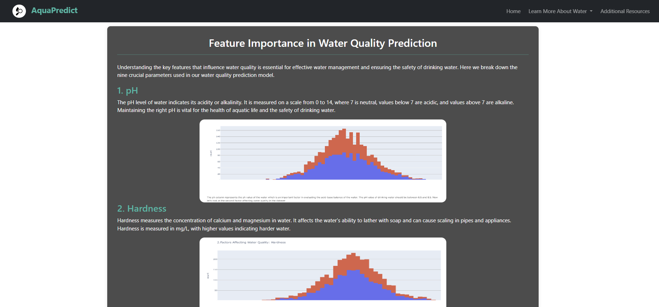
Page explaining the significance and impact of each parameter in determining water quality

Slide 23
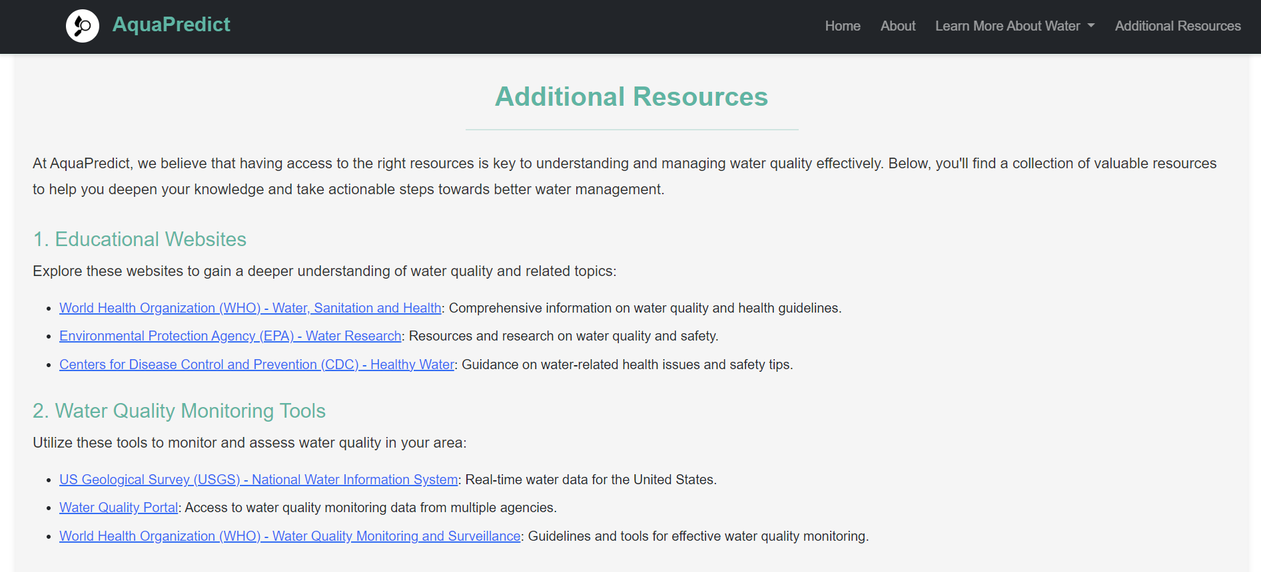
Page providing links and references to various websites and articles on water management and quality.

Slide 24
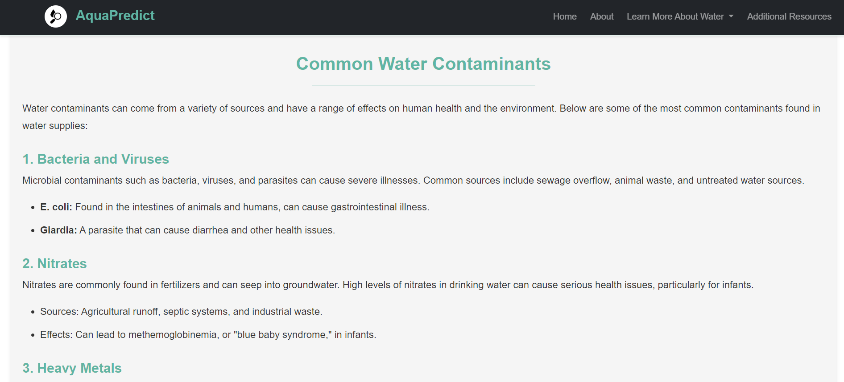
Page educating users about various water contaminants and their effects

Slide 25

Page featuring the project members, their roles, and the overall goal of the project.

Slide 26
Conclusion
The water quality predictor project aims to assess the potability of water based on various features.
After exploring and visualizing the dataset, we employed machine learning techniques, specifically a Random Forest classifier, to build a predictive model.
The project provides a reliable tool for users to input water quality features and receive predictions about water potability, contributing to ensuring access to safe drinking water

Slide 27

THANK YOU

